Slide 1
Introduction to Java

Slide 2

Objectives
At the end of this session, you will be able to
Download and install Java
Understand the Java architecture
Compile and run Java applications
Understand the language fundamentals
Use the control structures in programs
Use arrays and strings
Write programs using command line arguments

Slide 3
Agenda
Introduction to Java
Java Architecture
Setting up the environment
Language Fundamentals
Data types and operators
Control Structures
Arrays and Strings
Command line arguments

Slide 4
Introduction to Java
Java is :
A Programming language
A development environment
A deployment environment
Similar in syntax to C++; similar in semantics to Smalltalk
Operating system independent
Runs on Java Virtual Machine (JVM)
A secure operating environment that runs as a layer on top of the OS
A sandbox which protects the OS from malicious code
Object Oriented Programming language
In Java, everything is a class

Slide 5
Features of Java
Object oriented
Simple
Robust
Architecture neutral
Portable
Secure
High performance
Interpreted
Support for Multi-threading
Distributed

Slide 6
Platform Independence
A platform is the hardware & software environment in which a program runs
Once compiled, java code runs on any platform without recompiling or any kind of modification
“Write Once Run Anywhere”
Java Virtual Machine (JVM) made this possible

Slide 7
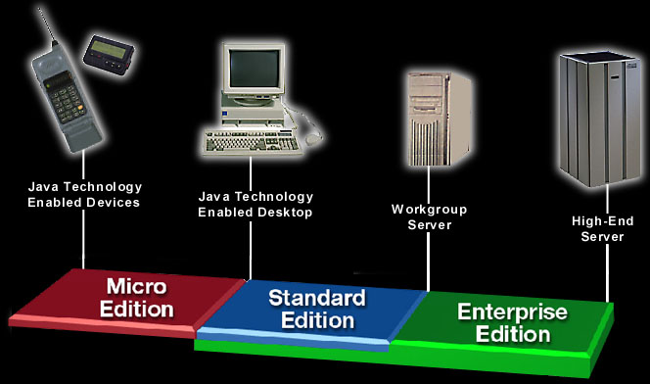
Java 2 Platform

Slide 8
Assembly Language
LDA #47
STA $570
DEX
JSR $817
CPX #0
BNE #14
Translation
program
(Assembler)
000101000011001010000100010010010101010101010010
Assembly language program
Machine language program
(executable file)

Slide 9
C Language
#include <stdio.h>
main()
{
printf(“Hallo”);
}
000101000011001010000100010010010101010101010010
C Compiler
Machine language program
(executable “.exe” file)
C Program

Slide 10
Java Architecture
JVM
Class Loader
Source File (HelloWorld.java)
Byte Code Verifier
Compiler (javac)
Interpreter
JIT Code Generator
Runtime
Byte code (HelloWorld.class)
Operating System
Hardware

Slide 11








public class Hello
public static void main(String[] args){
System.out.println("Hello World!");
}
}
Hello.java
javac (java compiler)
Interpreter
Interpreter
Interpreter
Interpreter
Bytecode (Class)
Hello.class
Write Once Run Everywhere !
Web Server

Slide 12
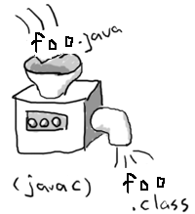
Java Compiler
Translates java code into platform independent byte codes
The byte code will be in a file with extension .class
Byte code is in binary language to be interpreted by JVM
Also performs strong type checking, prevents access violations etc.

Slide 13
Java Virtual Machine
JVM makes Java platform independent
Reads and executes compiled byte codes
Is implemented as software and is specific to each platform
The JVM interprets the .class file to the machine language of the underlying platform
The underlying platform then processes the commands given by the JVM
JVM provides definitions for the
Instruction set (CPU)
Class file format
Stack
Garbage-collection
Memory management

Slide 14

Development and Execution Infrastructure
File Name:
“Foo.java”
Class Foo{
.
.
…main(..){
}
}
Compiler
2. Compile It
1. Write a Program
Source files
(Java Language)
Input
Output
Virtual
Machine
3. Execute It
Linux
Intermediate
Files(Intermediate Language)
Virtual
Machine
File Name
“Foo.class”
Input
Mac OS X
Output
Virtual
Machine
Windows

Slide 15
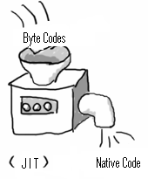
Just-In-Time Compiler (JIT)
Converts a part of the byte code to native code.
Requires more memory because both byte code and the corresponding native
code are in memory at the same time.

Slide 16
Java SE Platform Versions
Version Name | Code Name | Release Date
JDK 1.0 | Oak | January 1996
JDK 1.1 | (none) | February 1997
J2SE 1.2 | Playground | December 1998
J2SE 1.3 | Kestrel | May 2000
J2SE 1.4 | Merlin | February 2002
J2SE 5.0 | Tiger | September 2004
Java SE 6 | Mustang | December 2006
Java SE 7 | Dolphin | July 2011
Java SE 8 | (Not available) | March 2014

Slide 17
Java SE Development Kit (JDK)
Allows programmers to create, compile, and execute Java programs on a particular platform
Includes the command-line Java compiler (javac) and the Java Runtime Environment (JRE)
The JRE provides the runnable Java platform which supplies the java command needed to execute Java applications
Download and install JDK 7 from http://www.oracle.com/technetwork/java/javase/downloads/index.html

Slide 18
Environment Variables
JAVA_HOME: Java Installation Directory
CLASSPATH: Used to locate class files
PATH: Used by OS to locate executable files
Windows | set JAVA_HOME=C:\jdk1.7.0_51
UNIX | export JAVA_HOME=/var/usr/java
Windows | set CLASSPATH=%CLASSPATH%;%JAVA_HOME%\lib\tools.jar
UNIX | set CLASSPATH=$CLASSPATH:$JAVA_HOME/lib/tools.jar
Windows | set PATH=%PATH%;%JAVA_HOME%\bin
UNIX | set PATH=$PATH:$JAVA_HOME/bin

Slide 19
Hello World Program
Type the source code using any text editor
Save this as HelloJava.java
class HelloJava {
public static void main(String[] args) {
System.out.println(“Hello World”);
}
}
Compilation:
C:\> javac HelloJava.java
Running your first java program:
C:\> java HelloJava

Slide 20
Try it out
1. The Java compiler for Windows and Linux are same (True/False)
2. The JVM for Windows and Linux are same. (True/False)
3. Java compiler translates .java source files into ___________?
a) .exe file b) .bat file c) .doc file d) .class file
4. _________ converts the bytecode to native code.
a) JRE b) JVM c) JIT d) JDK
5. Which statement is used to compile a source code file HelloJava.java?.
a) C:\> java HelloJava.java b) C:\> javac HelloJava
c) C:\> javac HelloJava.java d) C:\> javac Hello.Java.java

Slide 21
Java Language Fundamentals

Slide 22
Comments
A single line comment starts with //
// This is a single line comment in Java
A multi line comment starts with /* and ends with */
/* This is a
Multi line
Comment in Java */

Slide 23
Keywords
abstract | continue | for | new | switch
assert | default | goto* | package | synchronized
boolean | do | if | private | this
break | double | implements | protected | throw
byte | else | import | public | throws
case | enum | instanceof | return | transient
catch | extends | int | short | try
char | final | interface | static | void
class | finally | long | strictfp | volatile
const* | float | native | super | while
* Keywords not in use now

Slide 24
Identifiers & Literals
An identifier (name) must begin with a letter, a dollar sign ($) or an underscore
character (_). Subsequent characters may be letters, $, _ or digits.
Classes, methods and variables cannot have Java Keywords as Identifiers
(names).
true, false and null are literals (not keywords), but they can’t be used as
identifiers as well.

Slide 25
Variables
A named storage location in the computer’s memory that stores a value of a particular type for use by program.
Example :
int myAge=28, cellPhone;
double salary;
char tempChar;
Variables can be declared anywhere in the program
for (int count=0; count < max; count++) {
int z = count * 10;
}
If a local variable is used without initializing, the compiler will show an error. The below is an error
int tempVal;
System.out.println(tempVal);

Slide 26
Data Types
The Data type can either be:
Built-in primitive type
Holds value
Reference data type
Holds reference to objects
Example
Memory Representation
int primitive = 5;
String reference = “Hello” ;
primitive
5
reference
Hello

Slide 27
Primitive Data Types
Data Type | Size (bits) | Type | Signed | Default Value | Min Value | Max Value
boolean | 1 | N/A | N/A | false | false | True
char | 16 | Single Unicode Character | ✗ | ‘\u0000’ | ‘\u0000’ (0) | ‘\uFFFF’ (2¹⁶ – 1)
byte | 8 | Integer | ✓ | 0 | -128(-2⁷) | 127 (2⁷ – 1)
short | 16 | Integer | ✓ | 0 | -2¹⁵ | 2¹⁵ – 1
int | 32 | Integer | ✓ | 0 | -2³¹ | 2³¹ – 1
long | 64 | Integer | ✓ | 0L | -2⁶³ | 2⁶³ – 1
float | 32 | Floating Point Number | ✓ | 0.0F | 1.4E-45 | 3.4028235E38
double | 64 | Floating Point Number | ✓ | 0.0 | 4.9E-324 | 1.7976931348623157 E308
Append uppercase or lowercase "L" or "F" to the number to specify a long or a float number.

Slide 28
Unicode Character Set
char data type in Java is 2 bytes because it uses UNICODE character set to support internationalization
UNICODE character set supports all known scripts and languages in the world

Slide 29
Operators
Type of Operators | Operators | Associativity
Postfix operators | [] . (parameters) ++ -- | Left to Right
Prefix Unary operators | ++ -- + - ~ ! | Right to Left
Object creation and cast | new (type) | Right to Left
Multiplication/Division/Modulus | * / % | Left to Right
Addition/Subtraction | + - | Left to Right
Shift | >> >>> << | Left to Right
Relational | < <= > >= instanceof | Left to Right
Equality | == != | Left to Right
Bit-wise/Boolean AND | & | Left to Right
Bit-wise/Boolean XOR | ^ | Left to Right
Bit-wise/Boolean OR | | | Left to Right
Logical AND (Short-circuit or Conditional) | && | Left to Right
Logical OR (Short-circuit or Conditional) | || | Left to Right
Ternary | ? : | Right to Left
Assignment | = += -= *= /= %= <<= >>= >>>= &= ^= |= | Right to Left

Slide 30
Conversions and Casting
Automatic type changing is known as Implicit Conversion
A variable of smaller capacity can be assigned to another variable of bigger capacity. This is called widening
int i = 10;
double d;
d = i;
Legal conversions are
byte → short → int → long → float → double
↑
char
Whenever a larger type is converted to a smaller type, we have to explicitly specify the type cast operator as narrowing is not allowed
double d = 10
int i;
i = (int) d;
Type cast operator

Slide 31
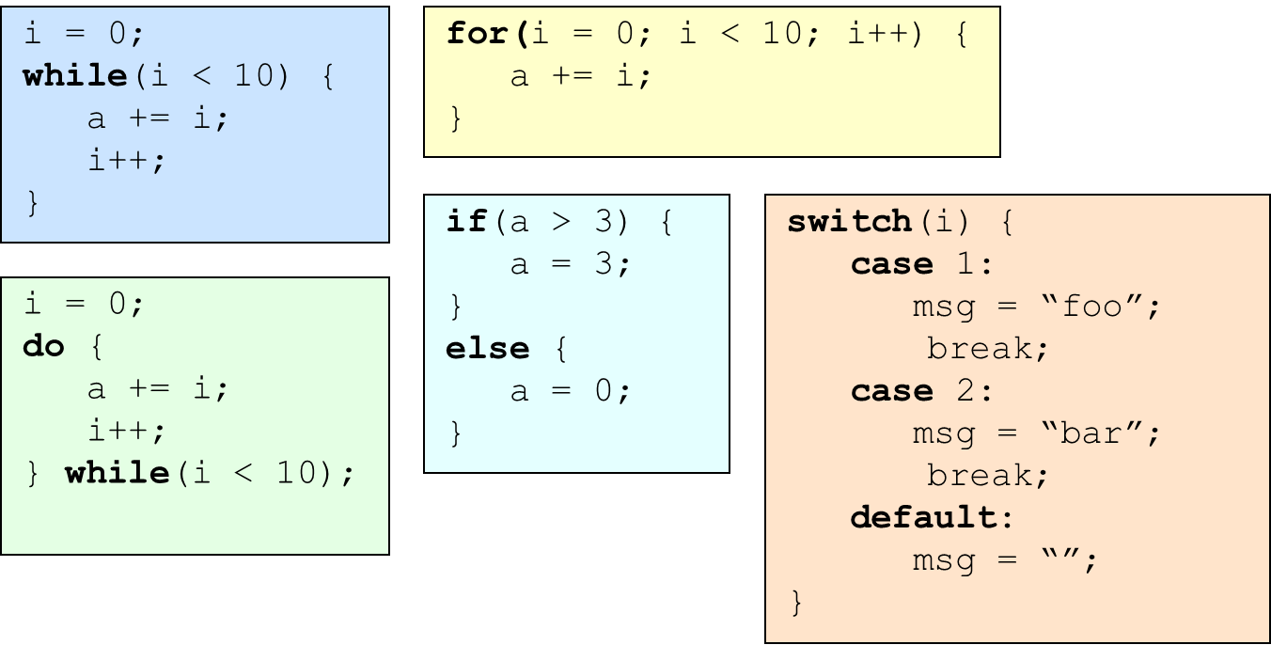
Control Structures
Work the same as in C / C++
if/else, for, while, do/while, switch

Slide 32
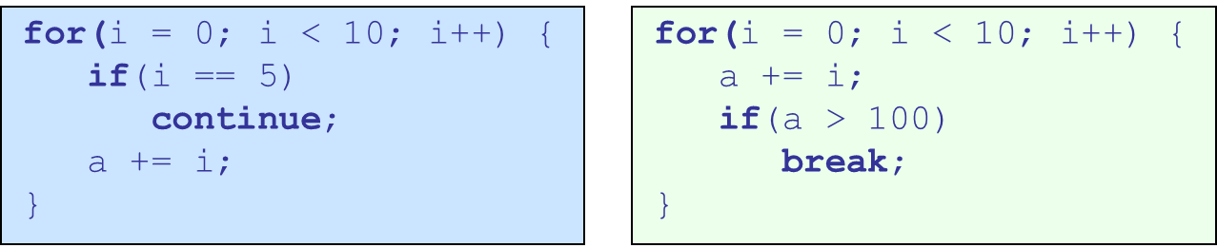
Flow Control Statements
Java supports continue & break keywords
A break statement will cause the current iteration of the innermost loop to stop and the next line of code following the loop to be executed.
A continue statement will cause the current iteration of the innermost loop to stop, and the condition of that loop to be checked, and if the condition is met, perform the loop again.

Slide 33

Arrays
An ordered collection of homogeneous data elements
Size to be specified at compile time and is static – cannot be modified
Arrays in Java are objects and can be of primitive data type or reference type
The length property on arrays tells the size of the array
An array holding 5 int elements
22
33
66
100
72
An array holding 4 Car objects
Reference to Car Object

Slide 34
Arrays
Arrays should be
Declared
int[] a; String b[]; Object []c;
Allocated (constructed)
a = new int[10];
b = new String[arraysize]
Initialized
for (int i = 0; i < a.length; a[i++] = 0)
An array can also be initialized while it is declared as follows:
int [] x = {1, 2, 3, 4};
char [] c = {‘a’, ‘b’, ‘c’};
Unlike C, Java checks the boundary of an array while accessing an element in it

Slide 35
Multidimensional Arrays
A Multi-dimensional array is an array of arrays
To declare a multidimensional array, specify each additional index using another set of square brackets
int [][] x;
//x is a reference to an array of int arrays
x = new int[3][4];
//Create 3 new int arrays, each having 4 elements
//x[0] refers to the first int array, x[1] to the second and so on
//x[0][0] is the first element of the first array
//x.length will be 3
//x[0].length, x[1].length and x[2].length will be 4

Slide 36
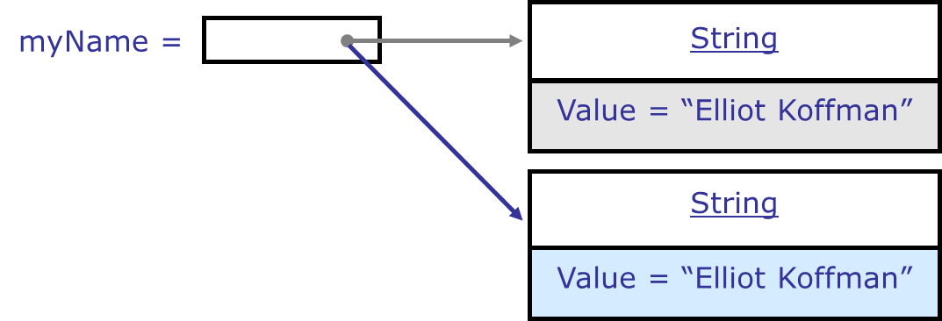
Strings
An object of the String class represents a fixed length, immutable sequence of unicode characters
All String operations (concat, trim, replace, substring etc) construct and return new strings.
String objects are immutable. If modified, Java creates a new object having the modified character sequence
String myName = “Elliot Koffman”;
myName = “Koffman, Elliot”;

Slide 37
Strings
public class StringDemo {
public static void main(String args[]){
char letter = 'a';
String string1 = "Hello"; // String literals are stored as String objects
String string2 = "World";
String string3 = "";
String dontDoThis = new String ("Bad Practice"); // Use is discouraged
string3 = string1 + string2; // + is to concatenate strings
System.out.println("Output: " + string3 + " " + letter);
}
}

Slide 38
String Operations
public class StringOperations {
public static void main(String arg[]){
String string2 = "World";
String string3 = "";
string3 = "Hello".concat(string2);
System.out.println("string3: " + string3);
// Get length
System.out.println("Length: " + string1.length());
// Get SubString
System.out.println("Sub: " + string3.substring(0, 5));
// Uppercase
System.out.println("Upper: " + string3.toUpperCase());
}
}
Notes:
This slide demonstrates some common string methods, including:
concat()
length()
substring()
toUpperCase()
To see what other methods can be used on a String, see the API documentation.
The output from the program is:
string3: HelloWorld
Length: 5
Sub: Hello
Upper: HELLOWORLD
Note: String is a class, not a primitive type. Instances of the class String represent sequences of Unicode characters. String literals are stored as String objects and "interned", meaning that for strings with matching characters, they all point to the same String object.

Slide 39
Arrays and for-each loop
public class ArrayOperations {
public static void main(String args[]){
String[] names = new String[3];
names[0] = "Blue Shirt";
names[1] = "Red Shirt";
names[2] = "Black Shirt";
int[] numbers = {100, 200, 300};
for (String name:names){
System.out.println("Name: " + name);
}
for (int number:numbers){
System.out.println("Number: " + number);
}
}
}
Notes:
This slide demonstrates some common string methods, including:
concat()
length()
substring()
toUpperCase()
To see what other methods can be used on a String, see the API documentation.
The output from the program is:
string3: HelloWorld
Length: 5
Sub: Hello
Upper: HELLOWORLD
Note: String is a class, not a primitive type. Instances of the class String represent sequences of Unicode characters. String literals are stored as String objects and "interned", meaning that for strings with matching characters, they all point to the same String object.

Slide 40
Command Line Arguments
Information that follows program’s name on the command line when it is executed
This data is passed to the application in the form of String arguments
class Echo {
public static void main (String args[]) {
for (int i = 0; i < args.length; i++)
System.out.println(args[i]);
}
}
C:\> java Echo Drink Hot Java
Drink
Hot
Java
Notes:
All Java applications contain a static method named main(). This method takes one argument that is an array of String objects.
These objects represent any arguments that may have entered by the user on the command line.
The number of command line arguments is obtained via the expression args.length. This is an int type.
The individual arguments are accessed as args[0], args[1] , args[2] and so forth.
Remember what ever we enter at command line are treated as strings .So if I have to take two numbers from command line and fine their sum then I have to take use of Wrapper Class which converts Reference(String) to primitive types.,

Slide 41
Try it out
1. Which of the following conversions are legal?
a) byte to int b) int to char c) float to double d) double to int
2. Array index starts at ___. Index is of ____ data type.
a) 1,int b) null, char c) 0,int
3. Java supports pointer arithmetic. (True/False)
4. Which of the below is a legal identifier?
a) _a b) –a c) 7g d) my Name
5. Will the below code compile?
int[5] scores;
6. Local variables get default values if not initialized. (True/False)

Slide 42
Summary
In this session, we have covered:
Java2 platform and its components
Java language fundamentals
Identifiers & Literals
Primitive Data Types & their Conversion
Operators & basic flow controls in java
Arrays & Strings
Command line arguments

Slide 43
Thank you

